Slide 1
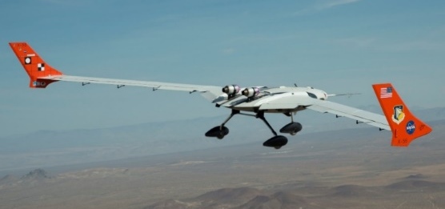
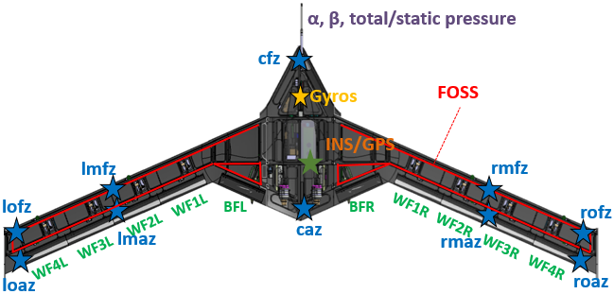
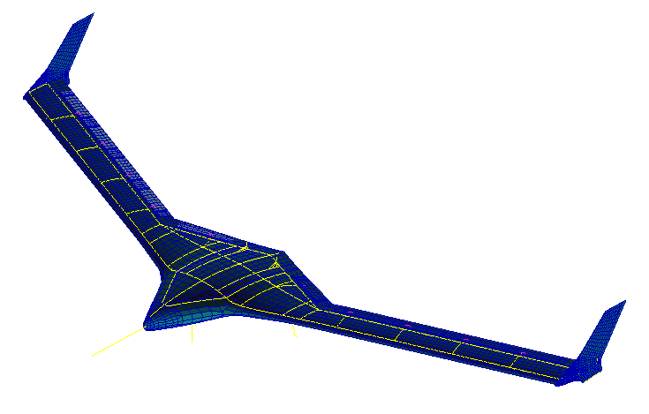
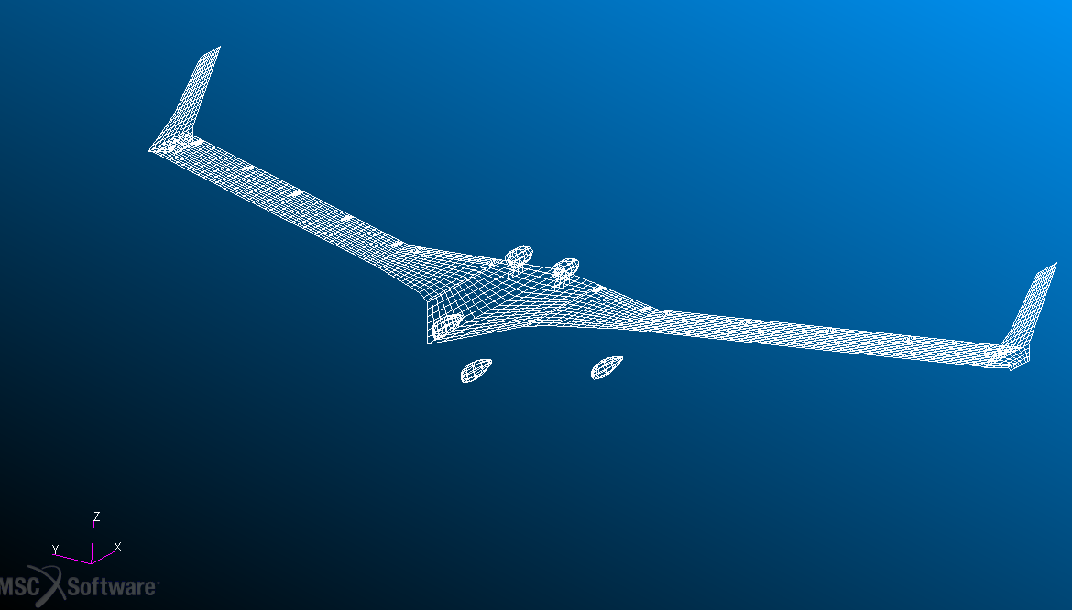
AePW-3: Flight Test Working Group
POC: jeffrey.a.ouellette@nasa.gov, alexander.w.chin@nasa.gov
Objectives
Background
Use X-56A as a case study for flutter prediction and ASE modeling improvements
Part 1: Predict blind flutter speed with flutter mode trends
Flutter analysis range from 0 to 200 KEAS
Flutter analysis based on mass condition (fuel) dependency
Document aero model formulation
Compare Vg and Vf trend plots
Leverage flight data as truth model for comparison studies (measured damping and frequency)
Although only the first flutter mode, Body Freedom Flutter, can be verified, secondary flutter modes at higher speeds can be analytically compared
Part 2: X-56 aeroelastic models for control
Compare with Low Order Equivalent System (LOES) models derived from flight data
Input/output control surface to sensor transfer function comparisons
Active control of flexible aircraft requires confidence in modeling formulation along with a thorough understanding of uncertainties and sensitivities to ensure appropriate controller robustness
The X-56A aircraft was designed with an active controller to suppress flutter and is heavily instrumented to provide flight data for better understanding flutter prediction models and increase confidence in aeroservoelastic modeling.
X-56 Vehicle Specifications
Released Materials
Pending Materials to Release for Comparison
Specifications:
500 lbs MTOW
(80 lbs Fuel)
28 ft span
BRS parachute
two P-400 JetCat engines
10 trailing edge control surfaces
Instrumentation
3 axis high rate gyro
10 z-axis accels
Fiber Optic Strain
Sensing (FOSS)
Airspeeds:
Takeoff ~65KCAS
Max Level ~135KCAS
Open Loop Flutter 105-120 KCAS
Finite Element Model
Flutter speed derived from flight data
Low Order Equivalent Models based on flight data
Aerodynamic Panel Model

